Slide 1
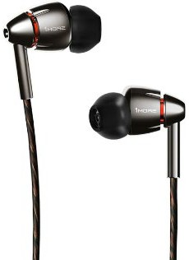
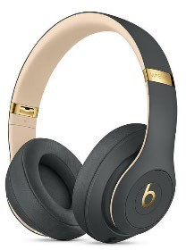
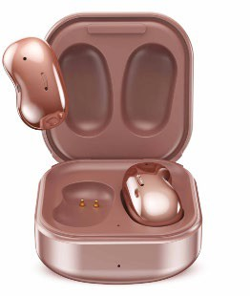
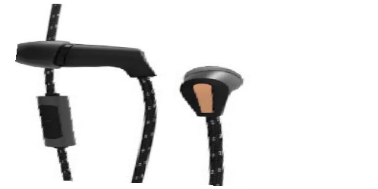
Headphones/Earbuds
Class 1 *Senior Reasons*
Sully is on the search for headphones or earbuds to take with her to school every day and keep in her backpack. Her main uses will include listening to audio books while studying and casually listening to music. She will listen from her cellphone. Comfort is important to her, as she plans to wear these for 3-5 hours of the day. She has $100 from her birthday to spend.
#1 Quad Driver In-Ear Headphones | #2 Beats Studio 3 Wireless Headphones | #3 Urban X Street Buds | #4 T5 Wired Headphones
dynamic audio, supreme comfort and durability into a compact but stylish package incredibly clear sound with all details from each frequency spectrum to others. Bass, highs and mids are faithful to the original audio at a Hi-Fi level. Corded 1/8” connector Tangle resistant cord 9 different silicone tip sizes | Pure Adaptive Noise Cancelling blocks external noise Soft over-ear cushions for extended comfort and added noise isolation Up to 22 hours of battery life Real-time audio calibration premium listening experience Bluetooth connection Comes with carrying case | The Fine-tuned 12mm speaker and enhanced bass tone play everything in studio- quality sound. Bluetooth connection Up to 4 hours of battery life Comes with charging case Sweat and water proof Sleek design | Water Resistant engineered to deliver a more comfortable in-ear audio experience, thanks to Klipsch's patented oval ear tips. The silicone tip fit is meant to increase both comfort and acoustics. 5mm dynamic driver that's tuned to provide high output and full bass. Corded 1/8” connector Compact and stylish
$90.99 | $79.99 | $49.94 | $69.99

Slide 2
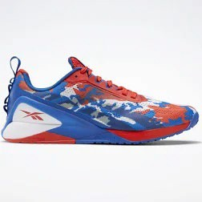
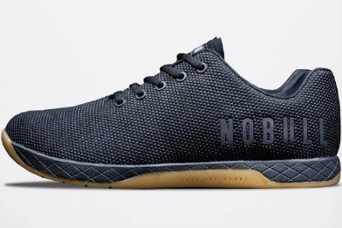
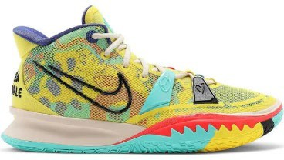
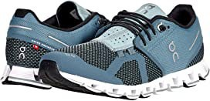
Athletic Shoes
Class 2 *Intermediate Reasons*
Cooper just joined a gym! He realized he needs a new pair of shoes that are comfortable during his workouts. His workouts include pushups, weight lifting, and running. He likes unique shoes with colors. But ultimately arch support and stability are most important to him. Cooper is willing to invest in a good pair of shoes, but his budget is $135.
#1 Nike Kyrie 7 Basketball Shoes | #2 On Cloudflow Running Shoes | #3 Reebok X1 Training Shoes | #4 No Bull Training Shoes
The 360-degree, computer- generated traction pattern helps you stay in control and move in and out of cuts. The rubber wraps up along the inner foot to give you traction when pushing off your edges Padded tongue and collar. Creative style on and off the court. Mesh details wrap around your foot to create a close, comfortable fit | A versatile trainer that is ideal for runners and other athletes alike. Breathable mesh upper with synthetic overlays that provide structural arch support where it is needed. Extra padded tongue and collar for comfort Weight: 7 ounces Removable sole is made from zero-gravity foam to combine stability and extreme comfort. | Lightweight Floatride Energy Foam cushioning responds to your every move. Weight: 9 ounces Directional traction pattern delivers a secure grip Low, flat and wide heels deliver great stability. Rubber wraps on the side provide abrasion resistance. | Run, climb, slide, grind, lift....these have you covered. Lightweight, breathable and flexible protection Weight: 9 ounces extremely durable, breathable and abrasion resistant material. The outsole was designed with the right blend of flexibility, traction and support
$125 | $120.99 | $150 | $124

Slide 3
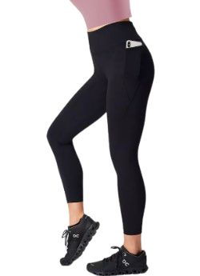
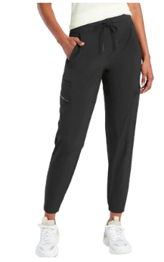
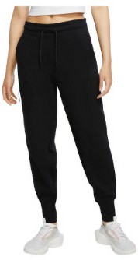
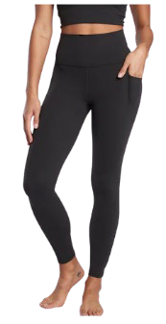
Active Wear
Class 3
Mary loves serving as a Healthy Texas Youth Ambassador and leading fitness activities. This year Mary wants to introduce the Dance Fit program to the elementary school. The classes will be held during May and June, both indoors and outdoors depending on weather. Mary is looking for comfortable and durable, high- waisted active wear pants with moisture wicking and anti-odor properties, that will retain their shape. She would like to have a pocket for her phone and keys. She has $70 to spend.
#1 Power Leggings | #2 Venture Jogger Pants | #3 Nike Comfort Pants | #4 Athleta Leggings
High-Waisted / Ankle Length Super soft and supportive 4-way stretch. 62% Polyamide 38% Elastane Sweat-wicking and quick-drying for all activities. Anti-odor properties. Temperature Control. Seamless for optimum comfort. Side pocket & Back zip pocket fits up to an iPhone 11. Adjustable drawstring. Machine wash. | Semi-fitted, skims easily over the body with a mid-rise waistband. Jogger fit, with loose leg and tapered bottom Featherweight Stretch™ fabric that feels silky sleek and light as air. Recycled 74% Polyester/ 19% Lyocell, 7% Spandex Seven pockets to store essentials. Breathable & wrinkle-resistant fabric that airs wrinkles out easily and dries quickly for comfort when breaking a sweat Machine wash. | Standard fit for a relaxed, easy feel. Lightweight construction An internal stash pocket helps keep your phone and keys in place. 69% cotton / 31% polyester; Pocket bags: 100% cotton. Add warmth to your look without extra weight or bulk with Nike® Tech Fleece. Surrounding tape highlights the signature zippered Tech Fleece Pockets Machine wash and dry. | Fitted, High rise/ Ankle Length Super lightweight and buttery soft interlock construction fabric with 4- way stretch for freedom of movement and holds shape. 75% Nylon/ 25%Lycra® Spandex Super Moisture Wicking & Quick drying capabilities Anti-odor Properties. Bonded side stash pockets hold your essentials Un-pinchable three-layer waistband with inner lining that streamlines and supports Flatlock seams for maximum comfort and to minimize chafe. Machine wash.
$60 | $50 | $45 | $65

Slide 4
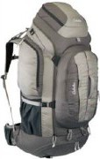
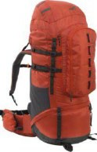
Outdoor Backpacks
Class 4 *Senior Reasons*
Jackson loves the outdoors and hiking. Jackson is planning a 4-day hiking trip and needs to find a durable outdoor backpack. Jackson needs a lightweight backpack with plenty of room to hold necessities (water, tools, etc.) Jackson needs at least 5 pockets and has a 22-inch torso.
Jackson would like a backpack with adjustable shoulder straps with nonslip pads. Water resistance is a plus. His budget is $200.
#1 Endicott Backpack | #2 Kelty Coyote Backpack | #3 Mountain Backpack | #4 High Sierra Backpack
Torso Length: 22" to 25" Weight: 6 lbs. 14 oz. Volume: 100 liters 1 top pocket, mesh interior pocket and ID pocket. 2 - side pockets, 2 - Water bottle pockets 420 denier polyester construction/Waterproof Adjustable Padded shoulder, waist and sternum straps. Camp roll straps on bottom of pack. | Torso Length: 15.5" - 20" Weight: 4 lbs. 13 oz. Volume: 65 liters PerfectFIT suspension delivers a like-custom fit LightBeam straps provide exceptional stability Mesh back panel, shoulder straps offer ventilation 1 large front pocket, 1 stretch front shove-it pouch, 2 hip belt pockets, water-bottle pockets, zippered side pockets. | Torso Length: 18" to 22" Weight: 5 lbs. 15 oz. Volume: 90 liters spandex suspension straps ensure excellent balance and stability 6 pockets Comes with both a small and extra-large removable padded waist belt with pockets. Rain cover keeps your camp gear dry when hiking in wet weather. | Torso Length: 15"-23" Weight: 4 lbs. 8 oz. Volume: 90 liters Airflow technology in the back panel for air circulation Adjustable shoulder straps with nonslip pads 1 large pocket, 2 side pockets, 1 zippered bottom pocket , 1 zippered interior pocket, 1 stretch-mesh exterior pocket Water-resistant coating to keep gear dry & rain cover.
$175 | $179 | $205 | $179

Slide 5
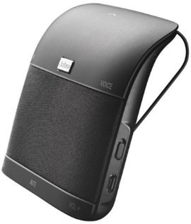
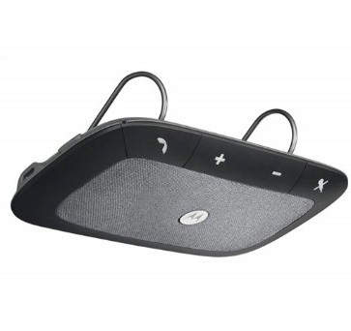
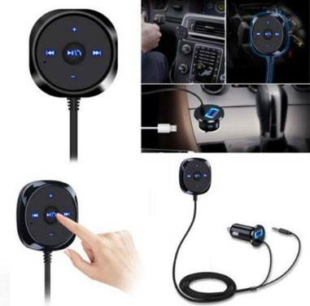
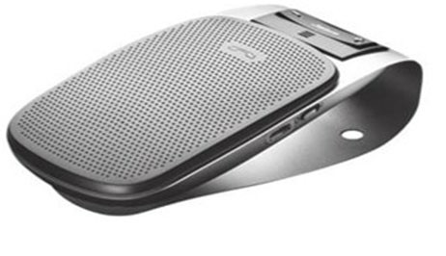
Handsfree Bluetooth Car Kit
Class 5
Kiara is a pizza delivery driver, she is looking for a hands-free Bluetooth set for her car. Her car is an older model and does not include Bluetooth pre-installed. She only has $60 to spend. She wants to take calls without having to hold her phone. Noise-cancellation would be a plus & she enjoys listening to music.
#1 Jabra Freeway Bluetooth Car Speaker | #2 Sonic Rider Bluetooth Car Speaker | #3 Drive 2.0 Bluetooth Car Speaker | #4 LanTune BlueTooth Car Speaker
Travel Charger + USB Cable included Rich, crisp sound from 3 speakers and Virtual Surround sound Use your voice to make and take calls completely hands- free; announces the name of the incoming caller, streaming for playback of music, podcasts and directions from GPS apps Up to 15 hours of talk time, | Exceptional echo and noise reduction help block road sounds while a powerful 2- watt speaker allows you to hear everything loud & clear battery gives you up to 45 hours of talk time Manage your calls hands- free by using your voice to "answer" or "ignore" calls audio prompts notify you about battery levels, announce callers by name, and much more. | Automatic volume adjustment and auto- paring to mobile phone Crystal clear sound with echo and noise cancellation connects to 2 Bluetooth devices at the same time Voice guidance announces battery level Completely handsfree 45 hours of talk time Connects to phone & radio, great for music | Push button for Answering/Ending/Rejecting a call, Redialing the last called number easily connects your smartphone to your car stereo crisp and clear audio for phone calls and music streaming 15 hours of talk time
$50 | $50 | $40 | $25

Slide 6
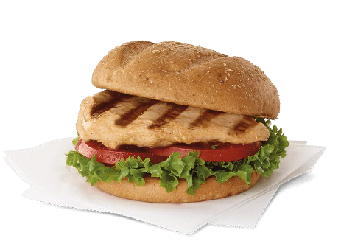
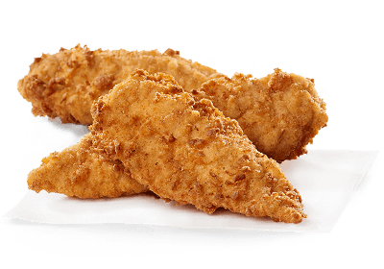
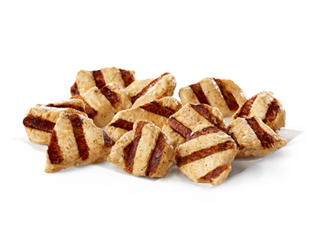
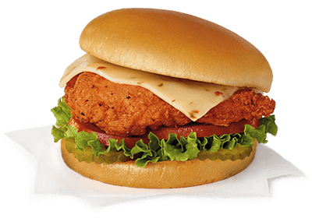
Mystery- Fast Food
Class 6 *Intermediates & Juniors ONLY*
Bailee travels a lot for work. Which means she has to eat mostly fast food meals while she is traveling. Bailee is trying to make healthy meal choices to watch her cholesterol. Her doctor advised her to stick to a low carb and low sodium diet. She does not want to spend more than $10 per meal. Which entree would be the best nutritional choice for Bailee?
#1 Grilled Chicken Sandwich | #2 3 count Chicken Strips | #3 12 count Grilled Nuggets | #4 Spicy Deluxe Sandwhich
Grilled chicken breast served on a multi-grain bun, tomato, and leafy green lettuce. 350 Calories 11 grams of Fat 30 grams of Carbohydrates 29 grams of Protein 700 milligrams of Sodium | Freshly lightly breaded chicken breast strips. 350 Calories 14 grams of Fat 20 grams of Carbohydrates 29 grams of Protein 850 milligrams of Sodium | Bit sized juicy grilled chicken breast nuggets 200 Calories 4.5 grams of Fat 2 grams of Carbohydrates 38 grams of Protein 650 Milligrams of Sodium | Breaded chicken breast, buttered bun, with pepper jack cheese, tomato and leafy green lettuce. 550 Calories 25 grams of Fat 47 grams of Carbohydrates 33 Grams of Protein 1,810 milligrams of Sodium
$5.35 | $4.39 | $5.35 | $4.89

